Slide 1



SOLAR PANEL DAMAGE DETECTION

Slide 2

Learning Objectives
Understand different types of solar panel defects.
Learn image preprocessing and augmentation techniques.
Build and train a CNN model for damage detection.
Evaluate model performance using accuracy and other metrics.
Develop an automated detection system using Python & Deep Learning.
Deploy the model using Streamlit for real-time predictions.
GOAL
Source :
www.freepik.com/

Slide 3
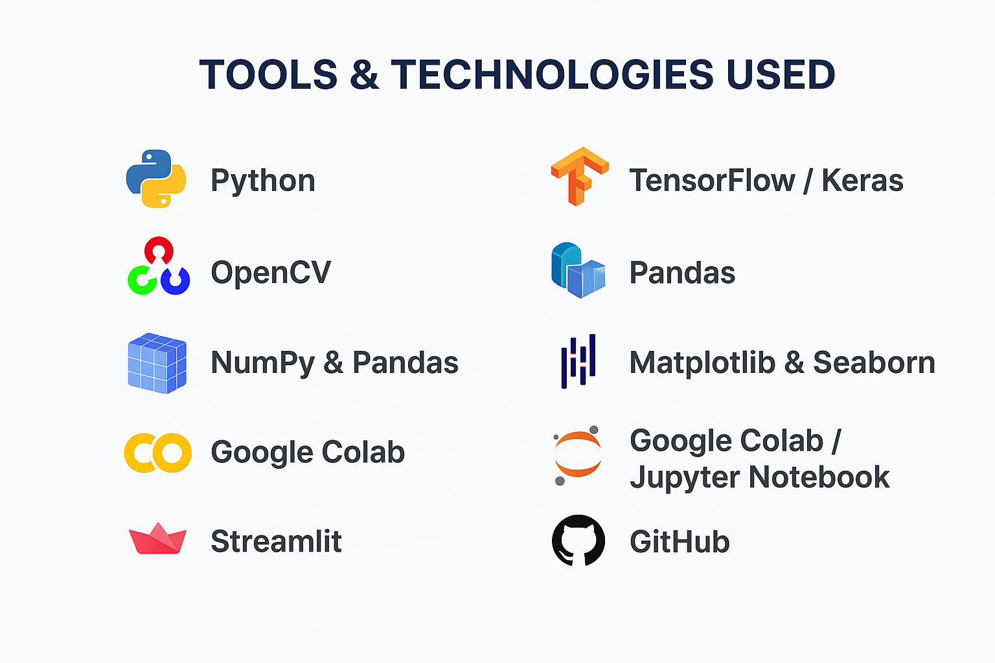
Tools and Technology used
Python – Core programming language
TensorFlow / Keras – Deep learning model development
OpenCV – Image preprocessing
NumPy & Pandas – Data handling and analysis
Matplotlib & Seaborn – Visualization
Google Colab / Jupyter Notebook – Model training environment
Streamlit – Frontend deployment
GitHub – Version control & project hosting

Slide 4
Methodology
Data Collection – Gathered solar panel images (damaged & healthy) from Kaggle and custom sources.
Preprocessing – Resized, normalized, augmented images; split into train/val/test sets.
Model Building – Developed a CNN using TensorFlow/Keras for binary image classification.
Training – Trained model with Adam optimizer and early stopping for best accuracy.
Evaluation – Tested using accuracy, confusion matrix, and F1-score (achieved ~94%).
Deployment – Built a Streamlit app for real-time solar panel damage prediction.
Documentation – Uploaded full project, code, and results to GitHub.

Slide 5
Problem Statement:
Solar panels play a crucial role in sustainable energy generation, but their performance drops significantly when they are cracked, dirty, or physically damaged. Manual inspection of large solar farms is slow, labour-intensive, and often inaccurate. Small cracks or hotspots are difficult to notice with the naked eye, leading to undetected faults. Lack of timely detection results in reduced power output and financial losses. Traditional inspection methods also require skilled technicians and expensive equipment. There is a growing need for an automated, reliable, and cost-effective monitoring system. Deep learning, especially Convolutional Neural Networks (CNN), can accurately classify solar panel conditions using images. By analysing images, a CNN model can detect damage faster and with higher precision than manual methods. This project aims to build a robust model to identify damaged vs. undamaged solar panels. The solution will support real-time monitoring, improved maintenance, and higher energy efficiency.

Slide 6
Solution:
An automated deep learning–based system is developed to detect solar panel damage from images. The solution uses a Convolutional Neural Network (CNN) trained on labeled panel images. The model classifies panels as damaged or undamaged with high accuracy. Image preprocessing techniques enhance clarity, reduce noise, and improve detection efficiency. The system reduces the need for slow, manual inspections. It provides consistent, reliable, and real-time fault detection. Technicians can monitor panel conditions remotely through a simple interface. The solution supports early identification of cracks, dirt accumulation, and hotspots. A Streamlit web app makes the model easy to use in real field conditions. Overall, the system improves energy output, reduces maintenance cost, and supports sustainable power generation.

Slide 7
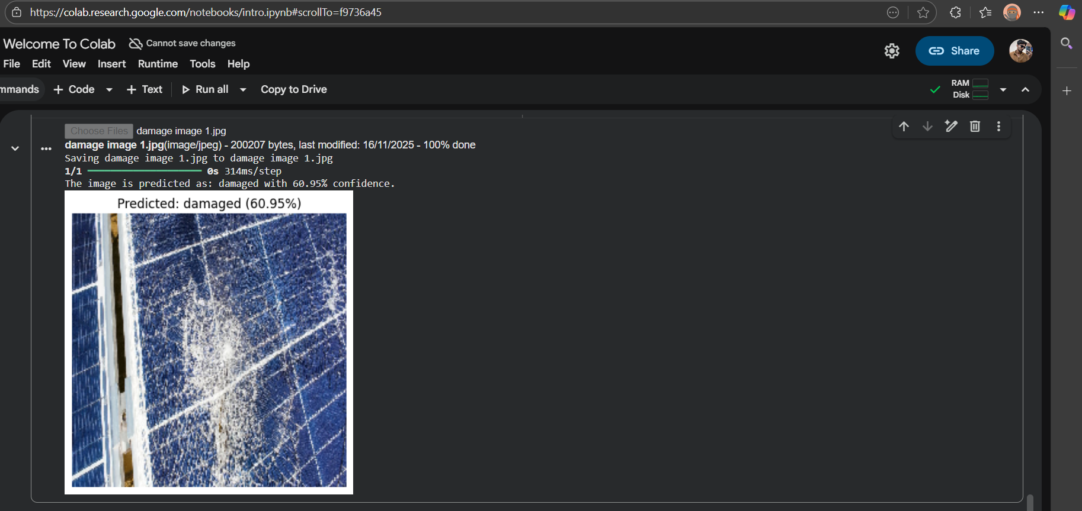
Screenshot of Output:
.

Slide 8
Conclusion:
The Solar Panel Damage Detection system successfully demonstrates how deep learning can automate the identification of cracks, dirt, and physical defects in solar panels. By using a CNN model with high accuracy, the project reduces dependency on manual inspections and enables faster, data-driven maintenance. The Streamlit interface makes the solution practical for real-time monitoring, improving efficiency and supporting sustainable energy management. This project highlights the potential of AI to enhance renewable energy systems and ensure optimal solar power generation.

Slide 9


